Slide 1

Applied data science capstone Michigan microbrewery
2020/04/18
Kevin Duncan

Slide 2
Agenda
1. Introduction
2. Data
3. Methodology
4. Results
5. Conclusions

Slide 3
1. Introduction
Craft Beer is popular in the United States, with a rapid expansion of Microbreweries across the Northeast, Michigan, and Northwest.
As of Calendar Year end 2017, there were over 6,200 Craft Breweries (Table 1).
Craft Brewing is potentially very profitable, especially once establishing distribution.
However, due to the expansion of Craft Brewing, new startups need to choose location wisely as the density of breweries increase in residential areas.
Key Point: If opening a Microbrewery, need to choose carefully to avoid jumping into a saturated market.

Slide 4
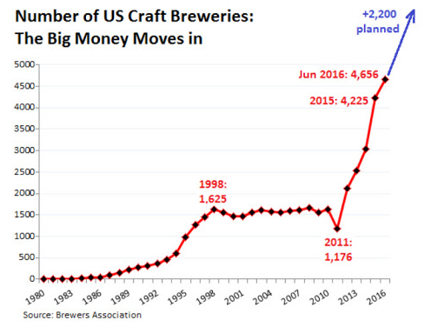
1. Introduction
(Table 1 – Craft Breweries in the United States)
Key Point: If opening a Microbrewery, need to choose carefully to avoid jumping into a saturated market.

Slide 5
1. introduction
Great Divide Brewing is hoping to expand into Michigan with a brewery and taproom.
Great Divide sells well with Household incomes over $75,000.
It offers a lineup of premium Microbrew styles, ranging from Bold IPAs to Easy Drinking Pilsners that appeal to more affluent and established professionals.
Find a Neighborhood in Michigan that meets these criteria but also has a low density of Breweries and Bars.
Neighborhoods should have a population greater than 15,000 to ensure sufficient sales demand.
Key Point: Find a Neighborhood with Income ≥$75k, pop ≥15,000, and minimum Bar/Brewery density.

Slide 6
2. dATA
Scrape or load Census data for Counties in Michigan that have for Household Income >$75k/year.
Scrape or load Census data for Neighborhoods within County that have Population >15K.
Use Foursquare to obtain Venue information for Neighborhoods.
Rank Venues based on prevalence for each Neighborhood, to understand types of venues are popular.
Cluster related Neighborhoods to look for areas with various types of eateries, social gathering places, that have a low density of Bars and Breweries.
Key Point: Scrape or load Census Data to get Demographic info. Use Foursquare to obtain Venues and popularity for Cities of interest. Cluster Cities to look for areas that have low occurrence of Bars/Breweries.

Slide 7
3. METHODOLOGY
Scrape or load Census data for Counties in Michigan that have for Household Income >$75k/year.
Reviewing US Census data, there was not readily locatable information that isolated Household Incomes by County.
As a result, Beautiful Soup was used to scrape Household Income by County. https://en.wikipedia.org/wiki/List_of_Michigan_locations_by_per_capita_income.html
Resulting Data was cleaned and sorted by Income to isolate Counties with Median Household income that met the criteria.
Scrape or load Census data for Neighborhoods within County that have Population >15K.
Again, US Census data was not readily available locatable information that isolated Population by City.
Population data was instead scraped from Wikipedia. https://en.wikipedia.org/wiki/Kent_County,_Michigan
Use Foursquare to obtain Venue information for Neighborhoods.
For Neighborhoods that have a population >15K, use Foursquare API to request popular venues.
Use One Hot encoding to analyze each neighborhood and group then rank by Category prevalence.
Cluster related Neighborhoods.
Used K-Means clustering to look for areas with various types of eateries, social gathering places, that have a low density of Bars and Breweries
Key Point: Scrape data to determine income and population. Use Foursquare to obtain and rank prevalence of venue categories. Use K-Means clustering Machine Learning to group neighborhoods. Review Clusters, looking for areas with eateries and social gathering places, but a low density of Bars and Breweries.

Slide 8
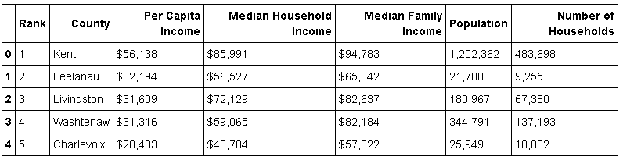
4. Results
Counties in Michigan that have for Household Income >$75k/year.
Kent County was determined to meet the Income Criteria.

Slide 9
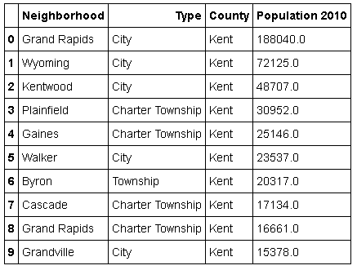
4. Results
Neighborhoods within Kent County that have Population >15K.
The Neighborhoods below met the population criteria

Slide 10
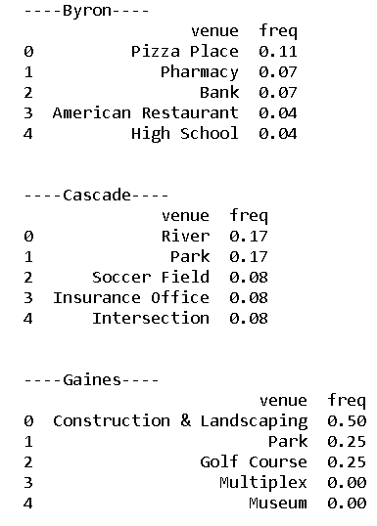
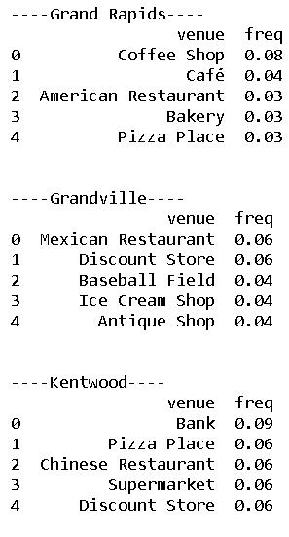
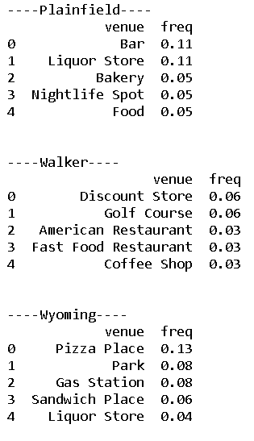
4. Results
Popular Venues per Foursquare.
Grand Rapids looks promising as its Top5 most popular spots are all Eateries.

Slide 11
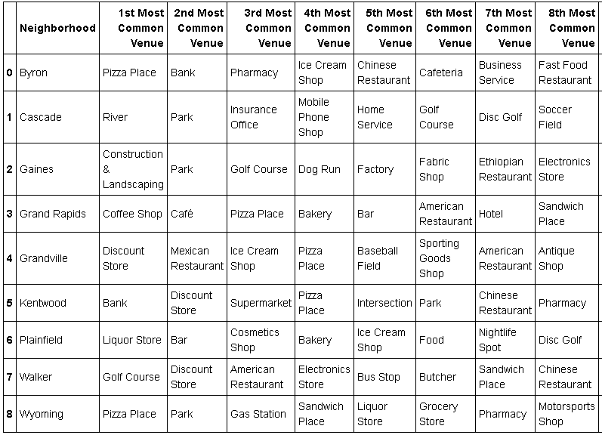
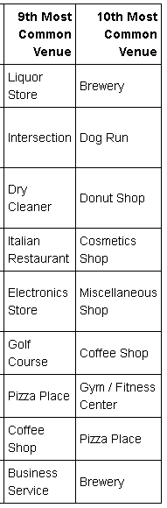
4. Results
Use One Hot encoding to analyze each neighborhood and group then rank by Category prevalence.
With a quick inspection, looks like Plainfield wouldn’t be a good choice due to Bars being the 2nd most common venue.

Slide 12
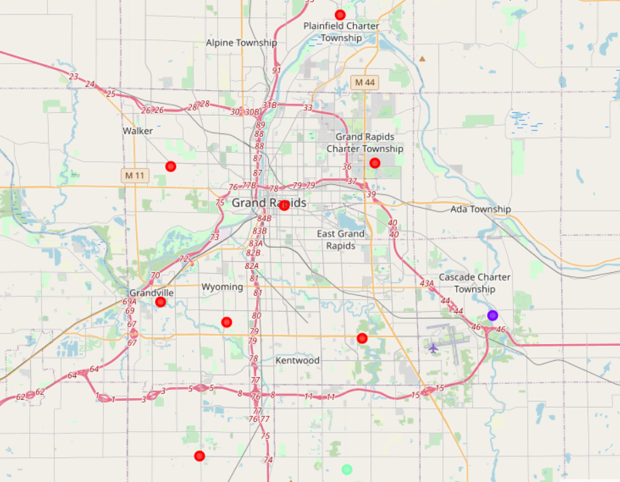
4. Results
Cluster related Neighborhoods.
Due to smaller dataset, created 3 Clusters using K-Means.
Cluster 0
Cluster 1
Cluster 2

Slide 13
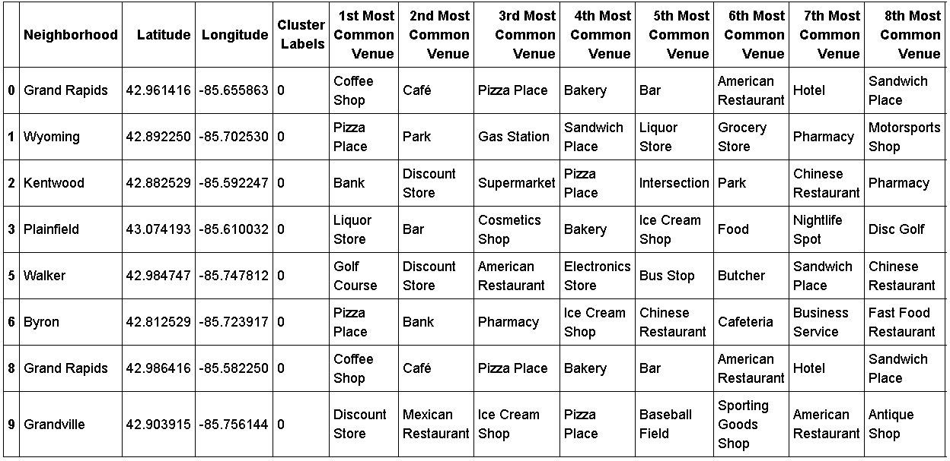
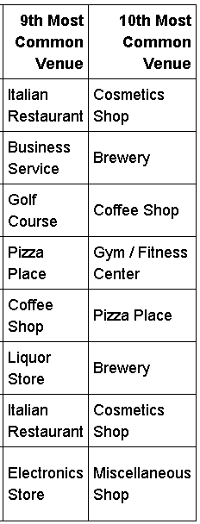
4. Results
Cluster 0.
Cluster 0 has a variety of cafe's and restaurants in the top 3 venues. This would be a good place to look for locating the Brewery, so long as bars and breweries are not common in the Neighborhood.
Grand Rapids
Township

Slide 14
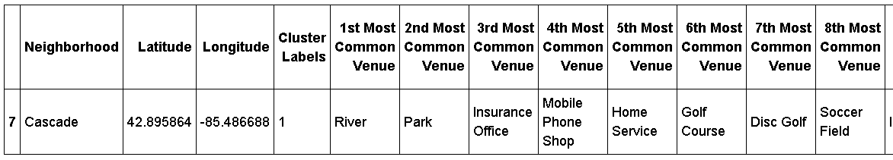
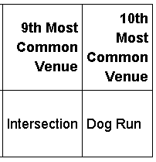
4. Results
Cluster 1.
Cluster 1 appears to be nature and commercial related. There would probably not be much demand or zoning for a brewery here.

Slide 15
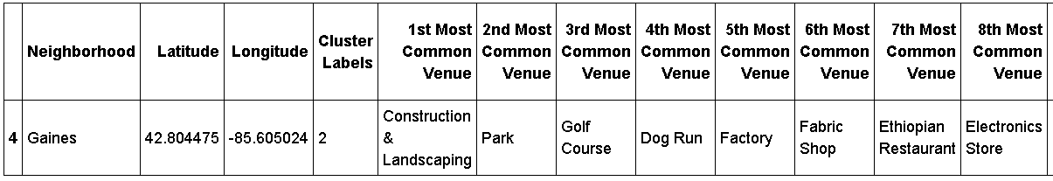
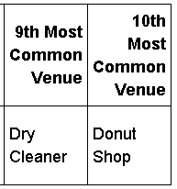
4. Results
Cluster 2.
Cluster 2 has appears to be recreation and industrial related. There would probably not be much demand or zoning for a brewery here either.

Slide 16
5. Conclusions
Michigan does have a region that would meet Great Divide’s Criteria for locating a Brewery and Tap Room.
Kent County met the Household Income >$75K Criteria, coming in at approx. $86k/year.
Within Kent County, there are several Neighborhoods that meet the >15K population criteria as well.
These Neighborhoods when Clustered into 3 groups, show Cluster 0 as the most likely group to for a brewery location. This is due a variety of cafe's and restaurants in the top 3 venues.
Within Cluster 0, Both Grand Rapids, and Grand Rapids Township appear the most promising, with 4 out 5 most prevalent Venues being related to Cafes, Eateries, but not Bars or Breweries.
It is recommended that Great Divide focus on these Neighborhoods for locating a brewery.

